Slide 1
F# Succinct, Expressive, Functional
Don Syme,
Principal Researcher
Microsoft Research, Cambridge

Slide 2
Topics
What is F# about?
Some Simple F# Programming
A Taste of Parallel/Reactive with F#

Slide 3
What is F# about?
Or: Why is Microsoft investing in functional programming anyway?

Slide 4
Simplicity

Slide 5
Economics

Slide 6
Fun, Fun and More Fun!

Slide 7
Simplicity

Slide 8
Code!
//F#
open System
let a = 2
Console.WriteLine a
//C#
using System;
namespace ConsoleApplication1
{
class Program
{
static int a()
{
return 2;
}
static void Main(string[] args)
{
Console.WriteLine(a);
}
}
}
More Noise
Than Signal!

Slide 9
Pleasure
Pain
type Command = Command of (Rover -> unit)
let BreakCommand =
Command(fun rover -> rover.Accelerate(-1.0))
let TurnLeftCommand =
Command(fun rover -> rover.Rotate(-5.0<degs>))
abstract class Command
{
public virtual void Execute();
}
abstract class MarsRoverCommand : Command
{
protected MarsRover Rover { get; private set; }
public MarsRoverCommand(MarsRover rover)
{
this.Rover = rover;
}
}
class BreakCommand : MarsRoverCommand
{
public BreakCommand(MarsRover rover)
: base(rover)
{
}
public override void Execute()
{
Rover.Rotate(-5.0);
}
}
class TurnLeftCommand : MarsRoverCommand
{
public TurnLeftCommand(MarsRover rover)
: base(rover)
{
}
public override void Execute()
{
Rover.Rotate(-5.0);
}
}

Slide 10
Pleasure
Pain
let swap (x, y) = (y, x)
let rotations (x, y, z) =
[ (x, y, z);
(z, x, y);
(y, z, x) ]
let reduce f (x, y, z) =
f x + f y + f z
Tuple<U,T> Swap<T,U>(Tuple<T,U> t)
{
return new Tuple<U,T>(t.Item2, t.Item1)
}
ReadOnlyCollection<Tuple<T,T,T>> Rotations<T>(Tuple<T,T,T> t)
{
new ReadOnlyCollection<int>
(new Tuple<T,T,T>[]
{ new Tuple<T,T,T>(t.Item1,t.Item2,t.Item3);
new Tuple<T,T,T>(t.Item3,t.Item1,t.Item2);
new Tuple<T,T,T>(t.Item2,t.Item3,t.Item1); });
}
int Reduce<T>(Func<T,int> f,Tuple<T,T,T> t)
{
return f(t.Item1) + f(t.Item2) + f (t.Item3);
}

Slide 11
Pleasure
Pain
type Expr =
| True
| And of Expr * Expr
| Nand of Expr * Expr
| Or of Expr * Expr
| Xor of Expr * Expr
| Not of Expr
public abstract class Expr { }
public abstract class UnaryOp :Expr
{
public Expr First { get; private set; }
public UnaryOp(Expr first)
{
this.First = first;
}
}
public abstract class BinExpr : Expr
{
public Expr First { get; private set; }
public Expr Second { get; private set; }
public BinExpr(Expr first, Expr second)
{
this.First = first;
this.Second = second;
}
}
public class TrueExpr : Expr { }
public class And : BinExpr
{
public And(Expr first, Expr second) : base(first, second) { }
}
public class Nand : BinExpr
{
public Nand(Expr first, Expr second) : base(first, second) { }
}
public class Or : BinExpr
{
public Or(Expr first, Expr second) : base(first, second) { }
}
public class Xor : BinExpr
{
public Xor(Expr first, Expr second) : base(first, second) { }
}
public class Not : UnaryOp
{
public Not(Expr first) : base(first) { }
}

Slide 12
You
Can
Interoperate
With
Everything

Slide 13
People
Love
Programming
in
F#

Slide 14
F#: Influences
OCaml
C#/.NET
F#
Similar core
language
Similar object
model

Slide 15
F#: Combining Paradigms
I've been coding in F# lately, for a production task. F# allows you to move smoothly in your programming style... I start with pure functional code, shift slightly towards an object-oriented style, and in production code, I sometimes have to do some imperative programming.
I can start with a pure idea, and still finish my project with realistic code. You're never disappointed in any phase of the project!
Julien Laugel, Chief Software Architect, www.eurostocks.com

Slide 16
F#: The Combination Counts!
Statically Typed
Succinct
F#
Libraries
Explorative
Interoperable
Efficient
Scalable

Slide 17
Let’s WebCrawl...

Slide 18
Orthogonal & Unified Constructs
Type inference. The safety of C# with the succinctness of a scripting language
Let “let” simplify your life…
Bind a static value
let data = (1, 2, 3)
let f (a, b, c) =
let sum = a + b + c
let g x = sum + x*x
(g a, g b, g c)
Bind a static function
Bind a local value
Bind a local function

Slide 19
Fundamentals - Whitespace Matters
let computeDeriative f x =
let p1 = f (x - 0.05)
let p2 = f (x + 0.05)
(p2 – p1) / 0.1
Offside (bad indentation)

Slide 20
Fundamentals - Whitespace Matters
let computeDeriative f x =
let p1 = f (x - 0.05)
let p2 = f (x + 0.05)
(p2 – p1) / 0.1

Slide 21
Orthogonal & Unified Constructs
Functions: like delegates + unified and simple
One simple
mechanism,
many
uses
(fun x -> x + 1)
let f x = x + 1
(f, f)
val f : int -> int
Lambda
predicate = 'T -> bool
send = 'T -> unit
Declare a
function
threadStart = unit -> unit
A pair
of function values
comparer = 'T -> 'T -> int
hasher = 'T -> int
A function type
equality = 'T -> 'T -> bool

Slide 22
Functional– Pipelines
x |> f
The pipeline operator

Slide 23
Functional– Pipelines
Successive stages
in a pipeline
x |> f1
|> f2
|> f3

Slide 24
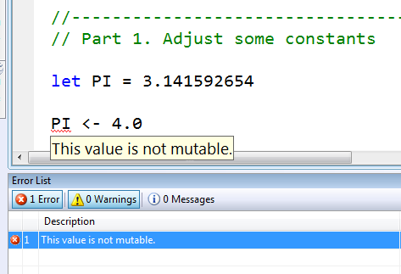
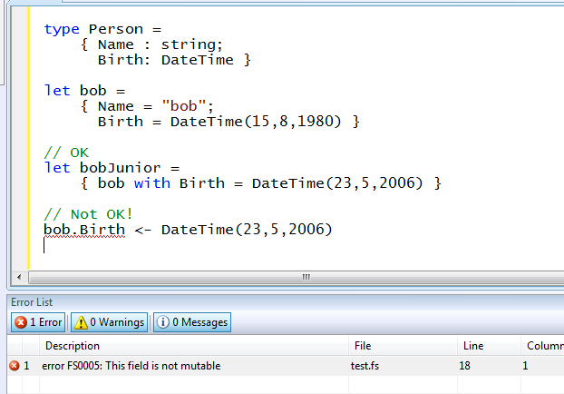
Immutability the norm…
Data is immutable by default
Values may not be changed
✓ Copy & Update
✗ Not Mutate

Slide 25
In Praise of Immutability
Immutable objects can be relied upon
Immutable objects can transfer between threads
Immutable objects can be aliased safely
Immutable objects lead to (different) optimization opportunities

Slide 26
Weakly Typed? Slow?
//F#
#light
open System
let a = 2
Console.WriteLine(a)
//C#
using System;
namespace ConsoleApplication1
{
class Program
{
static int a()
{
return 2;
}
static void Main(string[] args)
{
Console.WriteLine(a);
}
}
}
Looks Weakly typed?
Maybe Dynamic?
Notes:
But why does F# omit any type information? Is it not type safe? Is it coercive maybe? Or weakly typed? Maybe this is one of those dynamic languages I read about at 37 signals?

Slide 27
Typed
Untyped
Efficient
Interpreted
Reflection Invoke
F#
Yet rich, dynamic
Yet succinct
Notes:
But it has some features to make this a little more comfortable. We’ll see a bit of that later.

Slide 28
F# Objects

Slide 29
F# - Objects + Functional
type Vector2D (dx:double, dy:double) =
member v.DX = dx
member v.DY = dy
member v.Length = sqrt (dx*dx+dy*dy)
member v.Scale (k) = Vector2D (dx*k,dy*k)
Inputs to object construction
Exported properties
Exported method

Slide 30
F# - Objects + Functional
type Vector2D(dx:double,dy:double) =
let norm2 = dx*dx+dy*dy
member v.DX = dx
member v.DY = dy
member v.Length = sqrt(norm2)
member v.Norm2 = norm2
Internal (pre-computed) values and functions

Slide 31
F# - Objects + Functional
Immutable inputs
type HuffmanEncoding(freq:seq<char*int>) =
...
< 50 lines of beautiful functional code>
...
member x.Encode(input: seq<char>) =
encode(input)
member x.Decode(input: seq<char>) =
decode(input)
Internal tables
Publish access

Slide 32
F# - Objects + Functional
type Vector2D(dx:double,dy:double) =
let mutable currDX = dx
let mutable currDX = dy
member v.DX = currDX
member v.DY = currDY
member v.Move(x,y) =
currDX <- currDX+x
currDY <- currDY+y
Internal state
Publish internal state
Mutate internal state

Slide 33
Interlude: Case Study

Slide 34
The Scale of Things
Weeks of data in training:
N,000,000,000 impressions, 6TB data
2 weeks of CPU time during training:
2 wks × 7 days × 86,400 sec/day =
1,209,600 seconds
Learning algorithm speed requirement:
N,000 impression updates / sec
N00.0 μs per impression update

Slide 35
F# and adCenter
4 week project, 4 machine learning experts
100million probabilistic variables
Processes 6TB of training data
Real time processing

Slide 36
AdPredict: What We Observed
F#’s powerful type inference means less typing, more thinking
Type-inferred code is easily refactored
Quick Coding
Agile Coding
Scripting
Performance
Memory-Faithful
Succinct
Symbolic
.NET Integration
“Hands-on” exploration.
Immediate scaling to massive data sets
mega-data structures, 16GB machines
Live in the domain, not the language
Schema compilation and “Schedules”
Especially Excel, SQL Server

Slide 37
Smooth Transitions
Researcher’s Brain → Realistic, Efficient Code
Realistic, Efficient Code → Component
Component → Deployment

Slide 38
F# Async/Parallel

Slide 39
F# is a Parallel Language
(Multiple active computations)
F# is a Reactive Language
(Multiple pending reactions)
e.g.
GUI Event
Page Load
Timer Callback
Query Response
HTTP Response
Web Service Response
Disk I/O Completion
Agent Gets Message

Slide 40
async { ... }
A Building Block for
Writing Reactive Code
async { ... }
For users:
You can run it, but it may take a while
Or, your builder says...
OK, I can do the job, but I might have to talk to someone else about it. I’ll get back to you when I’m done

Slide 41
async { ... }
Asynchronous "non-blocking" action
async { let! image = ReadAsync "cat.jpg"
let image2 = f image
do! WriteAsync image2 "dog.jpg"
do printfn "done!"
return image2 }
Continuation/
Event callback
You're actually writing this (approximately):
async.Delay(fun () ->
async.Bind(ReadAsync "cat.jpg", (fun image ->
let image2 = f image
async.Bind(writeAsync "dog.jpg",(fun () ->
printfn "done!"
async.Return())))))

Slide 42
Code: Web Translation

Slide 43
Typical F# Reactive Architecture
Async.Start (async { ... }
...
Single Threaded GUI
Or
Single Threaded Page Handler
Or
Command Line Driver
Async.Parallel [ ... ]
(queued)
new Agent<_>(async { ... })
new WebCrawler<_>()
Internally: new Agent<_>(...) ...
event x.Started
event x.CrawledPage
event x.Finished

Slide 44
Taming Asynchronous I/O
using System;
using System.IO;
using System.Threading;
public class BulkImageProcAsync
{
public const String ImageBaseName = "tmpImage-";
public const int numImages = 200;
public const int numPixels = 512 * 512;
// ProcessImage has a simple O(N) loop, and you can vary the number
// of times you repeat that loop to make the application more CPU-
// bound or more IO-bound.
public static int processImageRepeats = 20;
// Threads must decrement NumImagesToFinish, and protect
// their access to it through a mutex.
public static int NumImagesToFinish = numImages;
public static Object[] NumImagesMutex = new Object[0];
// WaitObject is signalled when all image processing is done.
public static Object[] WaitObject = new Object[0];
public class ImageStateObject
{
public byte[] pixels;
public int imageNum;
public FileStream fs;
}
public static void ReadInImageCallback(IAsyncResult asyncResult)
{
ImageStateObject state = (ImageStateObject)asyncResult.AsyncState;
Stream stream = state.fs;
int bytesRead = stream.EndRead(asyncResult);
if (bytesRead != numPixels)
throw new Exception(String.Format
("In ReadInImageCallback, got the wrong number of " +
"bytes from the image: {0}.", bytesRead));
ProcessImage(state.pixels, state.imageNum);
stream.Close();
// Now write out the image.
// Using asynchronous I/O here appears not to be best practice.
// It ends up swamping the threadpool, because the threadpool
// threads are blocked on I/O requests that were just queued to
// the threadpool.
FileStream fs = new FileStream(ImageBaseName + state.imageNum +
".done", FileMode.Create, FileAccess.Write, FileShare.None,
4096, false);
fs.Write(state.pixels, 0, numPixels);
fs.Close();
// This application model uses too much memory.
// Releasing memory as soon as possible is a good idea,
// especially global state.
state.pixels = null;
fs = null;
// Record that an image is finished now.
lock (NumImagesMutex)
{
NumImagesToFinish--;
if (NumImagesToFinish == 0)
{
Monitor.Enter(WaitObject);
Monitor.Pulse(WaitObject);
Monitor.Exit(WaitObject);
}
}
}
public static void ProcessImagesInBulk()
{
Console.WriteLine("Processing images... ");
long t0 = Environment.TickCount;
NumImagesToFinish = numImages;
AsyncCallback readImageCallback = new
AsyncCallback(ReadInImageCallback);
for (int i = 0; i < numImages; i++)
{
ImageStateObject state = new ImageStateObject();
state.pixels = new byte[numPixels];
state.imageNum = i;
// Very large items are read only once, so you can make the
// buffer on the FileStream very small to save memory.
FileStream fs = new FileStream(ImageBaseName + i + ".tmp",
FileMode.Open, FileAccess.Read, FileShare.Read, 1, true);
state.fs = fs;
fs.BeginRead(state.pixels, 0, numPixels, readImageCallback,
state);
}
// Determine whether all images are done being processed.
// If not, block until all are finished.
bool mustBlock = false;
lock (NumImagesMutex)
{
if (NumImagesToFinish > 0)
mustBlock = true;
}
if (mustBlock)
{
Console.WriteLine("All worker threads are queued. " +
" Blocking until they complete. numLeft: {0}",
NumImagesToFinish);
Monitor.Enter(WaitObject);
Monitor.Wait(WaitObject);
Monitor.Exit(WaitObject);
}
long t1 = Environment.TickCount;
Console.WriteLine("Total time processing images: {0}ms",
(t1 - t0));
}
}
let ProcessImageAsync () =
async { let inStream = File.OpenRead(sprintf "Image%d.tmp" i)
let! pixels = inStream.ReadAsync(numPixels)
let pixels' = TransformImage(pixels,i)
let outStream = File.OpenWrite(sprintf "Image%d.done" i)
do! outStream.WriteAsync(pixels')
do Console.WriteLine "done!" }
let ProcessImagesAsyncWorkflow() =
Async.Run (Async.Parallel
[ for i in 1 .. numImages -> ProcessImageAsync i ])
Processing 200 images in parallel

Slide 45
Units of Measure

Slide 46
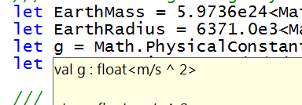
let EarthMass = 5.9736e24<kg>
// Average between pole and equator radii
let EarthRadius = 6371.0e3<m>
// Gravitational acceleration on surface of Earth
let g = PhysicalConstants.G * EarthMass / (EarthRadius * EarthRadius)

Slide 47
8 Ways to Learn
FSI.exe
Samples Included
Go to definition
Lutz’ Reflector
http://cs.hubfs.net
Codeplex Fsharp Samples
Books
ML/Erlang/Haskell/Clojure

Slide 48
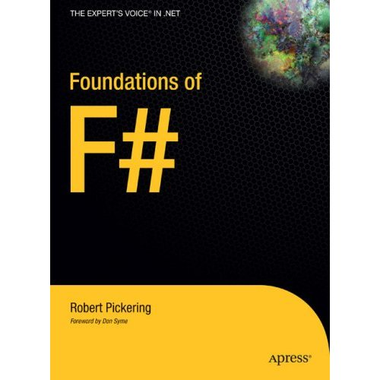
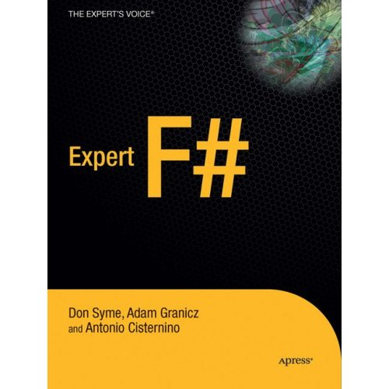
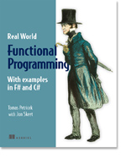

Books about F#
Visit www.fsharp.net

Slide 49
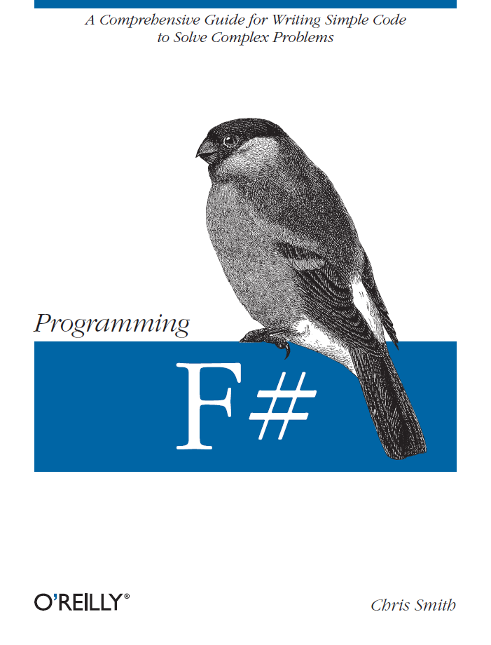
Books about F#
Visit www.fsharp.net

Slide 50
F# Ahead
F# will be a supported language in
Visual Studio 2010
Next stop: Visual Studio 2010 Beta 2
Look for it soon!

Slide 51
Questions & Discussion

